Slide 1
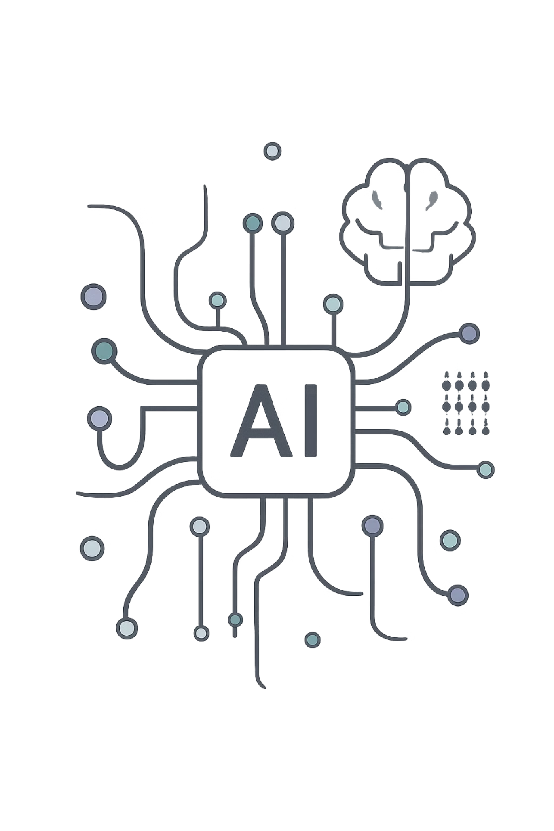
DevPilot AI
Intelligent Multi-Agent Software Engineering Assistant
Automating the Software Development Life Cycle (SDLC) using the OpenAI Agents SD

Slide 2
PROBLEM STATEMENT
Why DevPilot AI?
Modern software development is fragmented, slow, and error-prone. Engineers juggle too many manual steps across disconnected tools.
📋 Manual Analysis
⏱ Code Generation
Requirements parsed by hand — slow and inconsistent
Writing boilerplate and logic consumes critical dev time
🔍 Lengthy Reviews
🧪 Complex Testing
Manual code reviews introduce bottlenecks and blind spots
Test creation, execution, and bug investigation are siloed

Slide 3

PROJECT OVERVIEW
What is DevPilot AI?
DevPilot AI is an intelligent Multi-Agent Software Engineering Assistant built on the OpenAI Agents SDK. Instead of one general-purpose AI, it deploys specialized agents that collaborate to automate every phase of the SDLC.
Multi-Agent Collaboration
Reflection Loops
Parallel Execution
Shared Project Memory
Specialist agents work in concert, not in isolation
Self-improving code through iterative review cycles
Testing and documentation run simultaneously
Context persists across all agent interactions
Human-in-the-Loop
Critical actions require developer approval

Slide 4
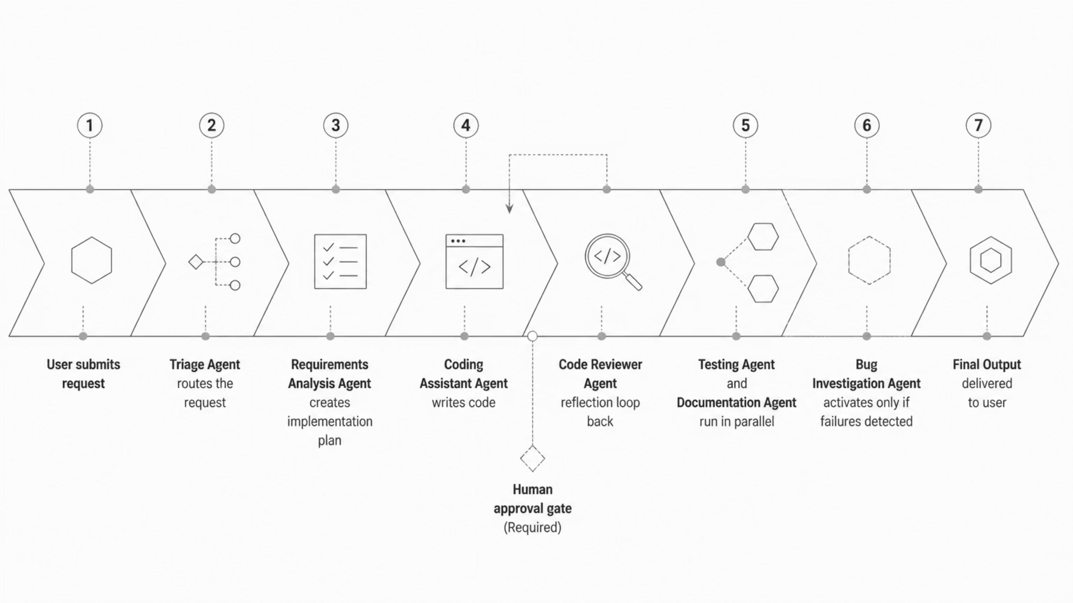

SYSTEM ARCHITECTURE
Multi-Agent Architecture
DevPilot AI orchestrates seven specialized agents in a structured pipeline. The Triage Agent acts as the entry point, routing each request to the right specialist. A reflection loop between the Coding Assistant and Code Reviewer ensures iterative quality improvement. Testing and Documentation execute in parallel to save time, while the Bug Investigation Agent activates only when failures are detected. Shared memory threads context across all agents, and human approval gates protect critical decisions.
Speaker Notes: Walk through the pipeline left to right. Highlight the reflection loop between Coding Assistant and Code Reviewer — this is what differentiates DevPilot from a simple code generator. Note the parallel Testing and Documentation stage, and the conditional Bug Investigation step. Mention the human approval gate before testing begins.

Slide 5
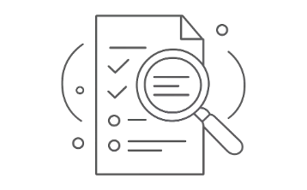
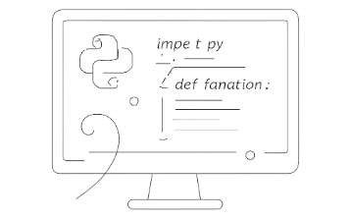

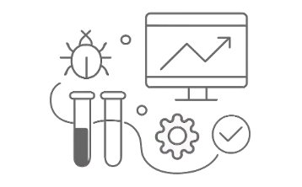


AI AGENTS
Specialized AI Agents
Requirements Analysis
Coding Assistant
Code Reviewer
Testing Agent
Understands user needs, creates implementation plans, and generates acceptance criteria
Generates production-ready Python code with pre-submission linting
Reviews correctness, coding standards, and security vulnerabilities
Generates PyTest cases, executes tests, and produces structured reports
Documentation Writer
Bug Investigation
Creates README files, installation guides, and user documentation
Investigates failures, finds root causes, suggests fixes, and searches GitHub issues

Slide 6
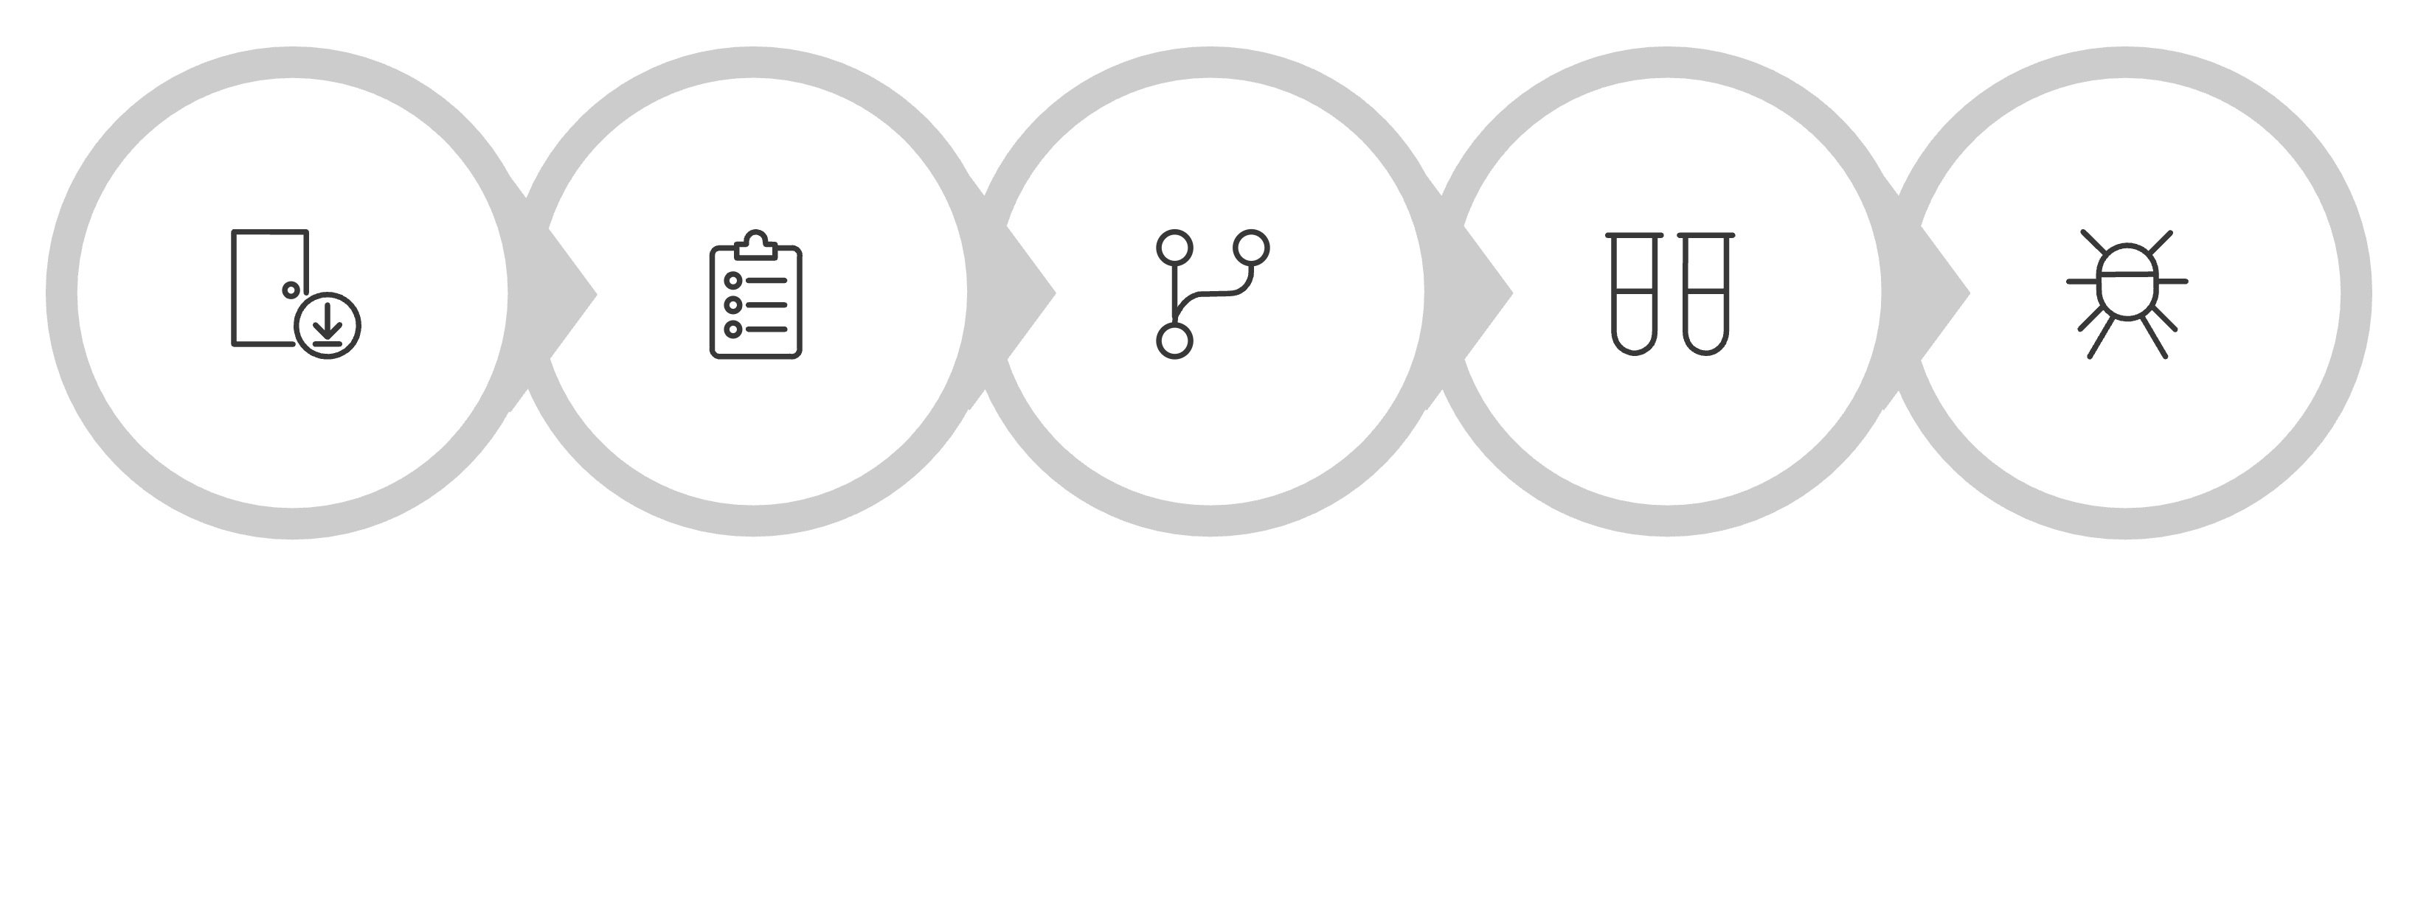
DEVELOPMENT WORKFLOW
End-to-End Development Workflow
Requirements
Analysis
Coding
Test & Docs
Bug Fix
🔁 Reflection Loop
⚡ Parallel Execution
🤝 Agent Collaboration
Code Reviewer sends feedback back to Coding Assistant for iterative improvement before proceeding
Testing and Documentation run simultaneously, cutting total pipeline time significantly
Shared memory and structured handoffs keep all agents aligned on project context

Slide 7
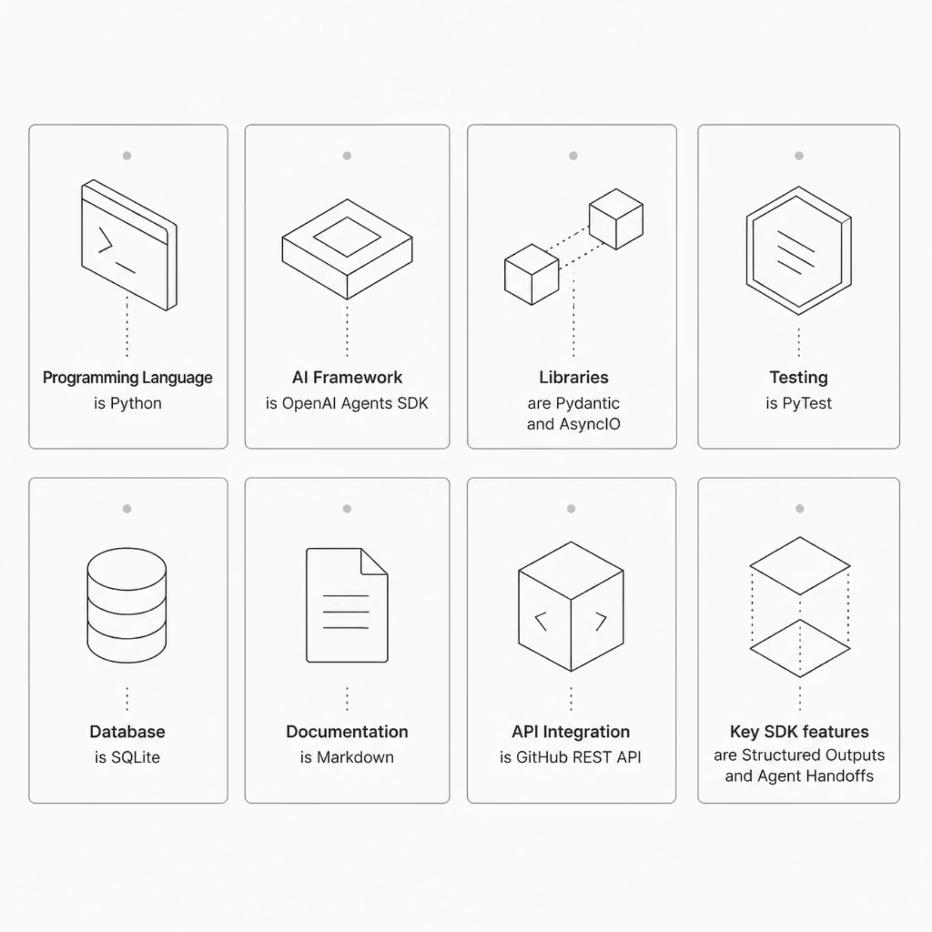
TECH STACK
Technologies Used
Built for Reliability & Scale
DevPilot AI leverages a modern, Python-native stack designed for async agent
orchestration and robust structured data handling.
OpenAI Agents SDK
Pydantic + AsyncIO
GitHub REST API
Core framework for agent creation, handoffs, and memory
management
Structured data validation and non-blocking concurrent execution
Enables real-world issue search and repository integration

Slide 8
KEY FEATURES
What Makes DevPilot AI Powerful
Multi-Agent Architecture
Automated SDLC
Specialist agents collaborate with shared memory and structured handoffs
From requirements to tested, documented code — fully automated
Reflection-Based Improvement
Parallel Execution
Iterative review loops continuously elevate code quality
Testing and documentation run simultaneously for speed
Human-in-the-Loop
Bug Investigation
Critical decisions require developer approval before proceeding
Root cause analysis with GitHub issue search integration

Slide 9
FUTURE SCOPE
Future Enhancements
DevPilot AI is a living platform. The roadmap targets full-stack autonomy — from local development to cloud deployment.
Phase 1
1
Multi-language code generation · Docker containerization support
2
Phase 2
Cloud deployment · Web dashboard for project management
Phase 3
3
GitHub Pull Request automation · Project analytics dashboard
4
Phase 4
Notification system · Plugin architecture for extensibility
"Towards a Fully Autonomous AI Software Engineering Platform."

Slide 10
CONCLUSION
Conclusion
Automates the Complete SDLC
Improves Productivity & Quality
Augments, Not Replaces, Developers
From requirement to release — every phase is handled by a specialized AI agent
Reflection loops, parallel execution, and automated testing raise the bar
Human-in-the-loop approval keeps engineers in control of critical decisions
DevPilot AI demonstrates how collaborative AI agents can transform modern software engineering.

